Slide 1
Course Name (Section: X )
Project Presentation (Semester: Spring 24-25 )
Project Title: Automatic Street Light System
Group No: 05
Submission Date:1 June 2025
Group Members:
Roll No. | Student ID | Student Name
10 | 23-52980-3 | Rafid Hossain
11 | 23-52991-3 | Md. Abu Siam
13 | 23-53029-3 | Asma Akther
12 | 23-52993-3 | Zihad Bin Rahim
9 | 23-52979-3 | Linda Maria Gomes
3 | 23-50839-1 | Md. Zihad Khan
Lab Instructor: Dr Nadia Afroze
Lab Demonstrator: MD. Shahin Islam

Slide 2
Outlines of the project
Aims & Objectives
Introduction
Methodology
Results
Discussion
Conclusion
References

Slide 3
1. Aims & Objectives
To design a sensor-based circuit that can detect ambient light levels using an LDR (Light Dependent Resistor).
To automatically switch ON the streetlight when the surrounding light intensity falls below a certain threshold (e.g., during dusk or cloudy weather).
To switch OFF the streetlight automatically during daylight hours to conserve energy.
To reduce human effort and operational costs involved in manual switching of streetlights.
To demonstrate a prototype model of the system with proper component integration and functioning.
To ensure the system is energy-efficient, reliable, and suitable for real-world outdoor implementation.

Slide 4
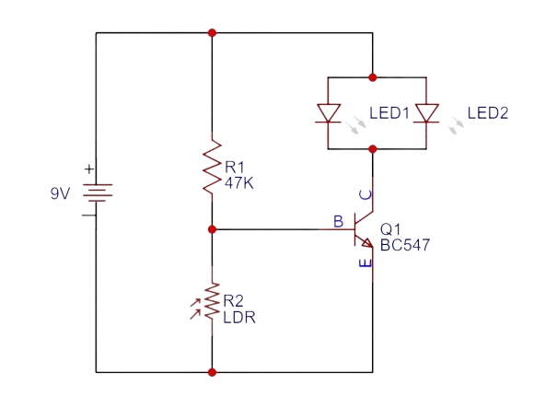
2. Introduction
In today’s world, automation plays a key role in improving efficiency, saving energy, and reducing manual effort. Street lighting is one area where automation can prevent unnecessary power consumption caused by manual switching or fixed timers. This project aims to develop an Automatic Street Light System that operates based on ambient light conditions using a Light Dependent Resistor (LDR).
The LDR senses the surrounding light level, and when it drops below a set threshold—like during dusk or nighttime—the system automatically turns ON the streetlight. When sufficient daylight is detected, the light switches OFF. This smart, energy-efficient system uses simple and cost-effective components, making it ideal for both urban and rural applications to promote sustainable energy use.
Figure 1: Circuit Diagram

Slide 5
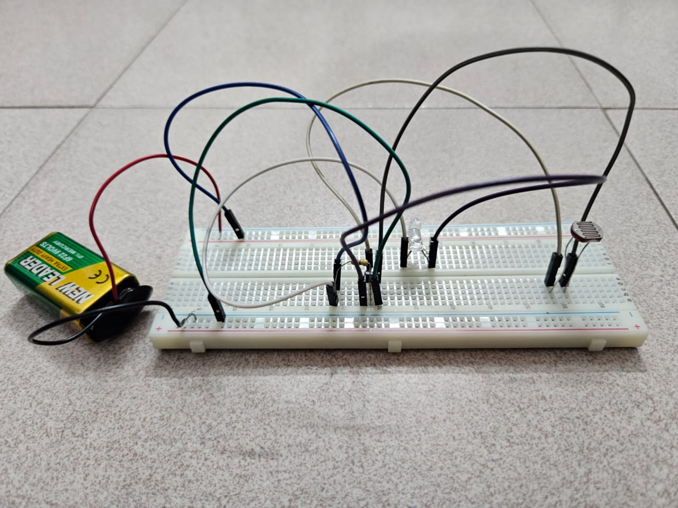
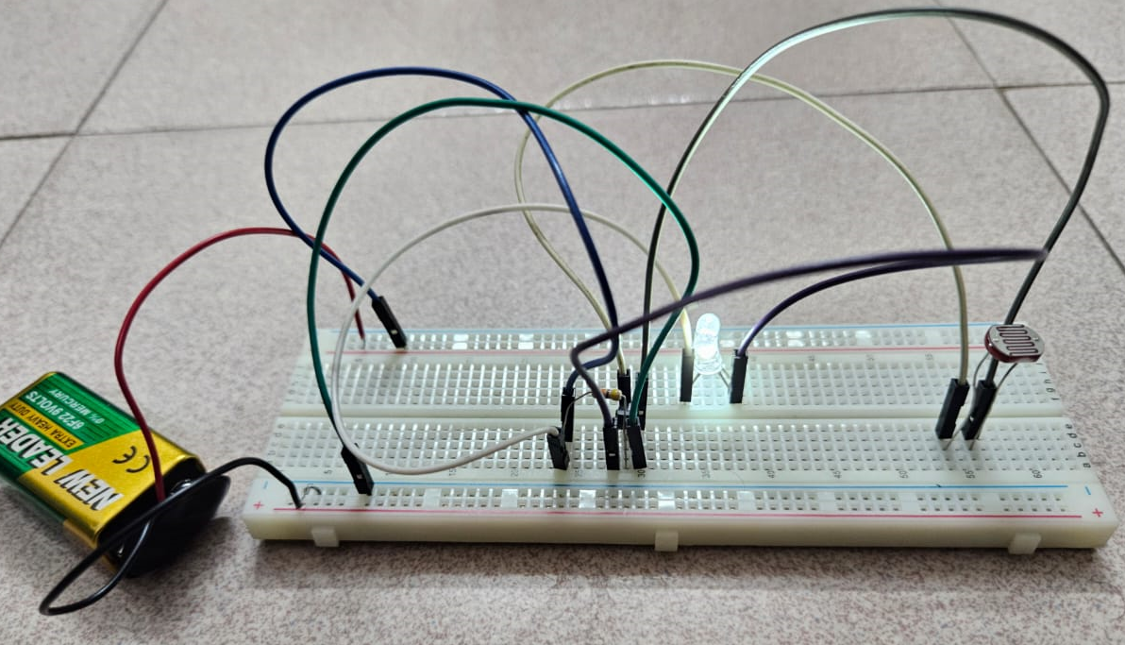
3. Methodology
Light Sensing: The LDR detects ambient light intensity and generates a voltage signal that decreases as the surrounding light fades.
Transistor Switching: The BC547A transistor receives the voltage signal from the LDR through a voltage divider. When it gets dark, the reduced voltage at the base allows the transistor to conduct.
LED Activation: In low light or darkness, the transistor switches ON, allowing current to flow through the LED, which lights up. In bright light, the transistor remains OFF, keeping the LED off.
Testing: The circuit was tested in various lighting conditions (daylight, shade, and complete darkness) to verify that the LED activates accurately in the absence of light.
Figure 2: Hardware Demonstration (In Daylight)
Figure 3: Hardware Demonstration (In Darkness)

Slide 6
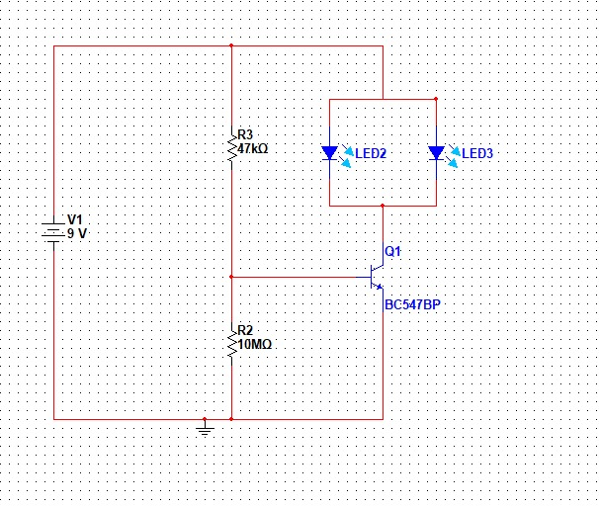
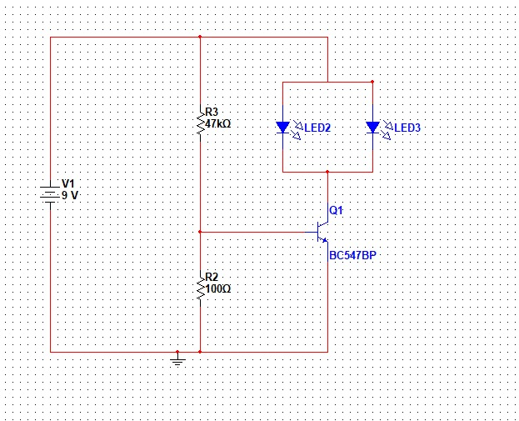
4. Results
The automatic street light system successfully detected changes in ambient light using the LDR sensor.
The streetlight (represented by an LED) turned ON automatically in low-light conditions (e.g., darkness or shadow).
The LED turned OFF automatically in bright light conditions (e.g., sunlight or strong artificial light).
The system responded accurately and promptly to changing light levels without the need for manual control.
Power consumption was reduced, as the light only operated when necessary.
The prototype demonstrated reliable and consistent performance during multiple tests under different lighting environments.
Figure 4: Simulated Diagram
Figure 5: Simulated Diagram

Slide 7
5. Discussion
The Automatic Street Light System worked effectively by turning the LED on in low light and off in bright conditions. The LDR senses ambient light, and its resistance changes accordingly. In darkness, the increased resistance causes the transistor (BC547P) to switch ON, allowing current to light the LED. In bright light, the transistor stays OFF, and the LED remains off. Testing under various conditions confirmed reliable and accurate switching. The circuit is simple, cost-effective, and suitable for real-life applications like automatic night lights and solar garden lighting.

Slide 8
6. Conclusion
The Automatic Street Light System was successfully designed and implemented using an LDR and a BC547 transistor. The system effectively responded to changes in ambient light, turning the light ON in darkness and OFF in daylight without any manual intervention. This project demonstrates a simple, low-cost, and energy-efficient solution for automating street lighting.
By reducing unnecessary power consumption and human effort, this system contributes to energy conservation and can be scaled for real-world applications. The project also highlights how basic electronic components can be used to build functional and practical automation systems. Future improvements can include features like motion sensors, timers, or solar power for enhanced efficiency and Sustainability

Slide 9
7. References
Boylestad, R. L., & Nashelsky, L. (2009). Electronic Devices and Circuit Theory (11th ed.). Pearson Education.
Chapter 3: Diodes and Applications
Electrical Technology. (2013, April). Automatic Street Light Control Circuit using LDR & Transistor. Retrieved from (Electrical Technology)
Easy Electronics Project. (2020, April 15). Automatic Street Light with LDR. Retrieved from (Electronics Projects)
ElectronicWings. (2020, September 29). Automatic Street Light Controller. Retrieved from (ElectronicWings)
TRONICSpro. (n.d.). How to Make Automatic Street Light Controller. Retrieved from (TRONICSpro)

Slide 10

Thanks for listening

